Slide 1
R-K METHOD
By
Doyel Sarkar

Slide 2
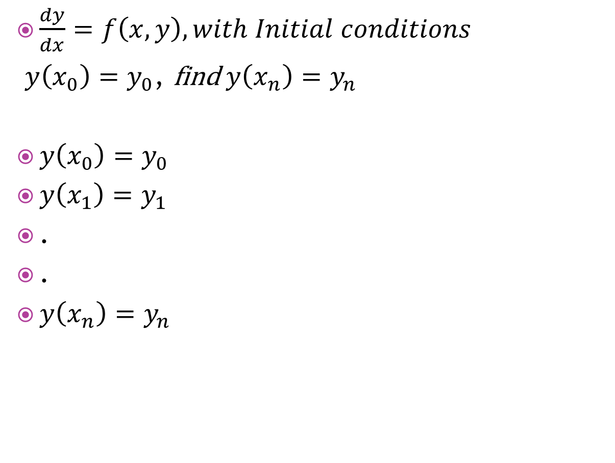
RUNGE KUTTA Method
$\frac{dy}{dx}=f\left(x,y\right), with Initial conditions$
$y\left(x_{0}\right)=y_{0}$, find $y\left(x_{n}\right)=y_{n}$
$y\left(x_{0}\right)=y_{0}$
$y\left(x_{1}\right)=y_{1}$
.
.
$y\left(x_{n}\right)=y_{n}$

Slide 3
Working Formula OF ORDER 4
Formula

Slide 4

Example1
Compute $y(0.4)$ from the equation
$\frac{dy}{dx}=xy+y^{2}$ given that $y\left(0\right)=1$

